Slide 1
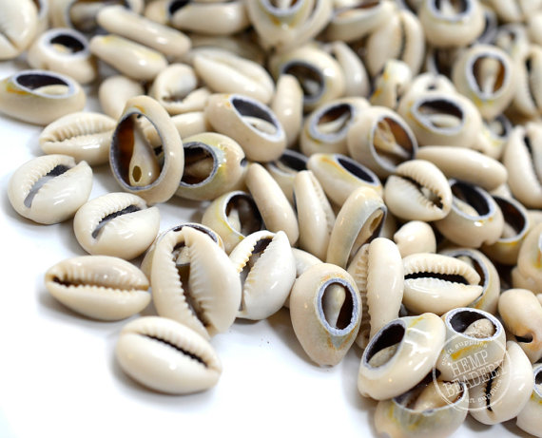
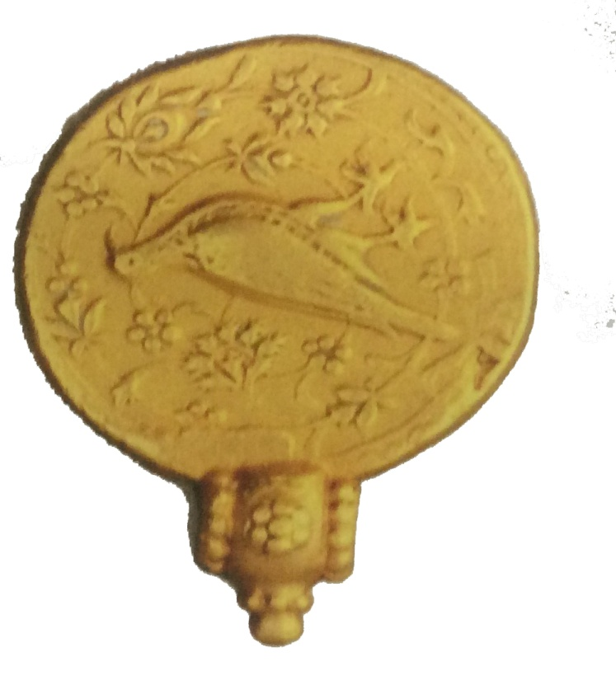
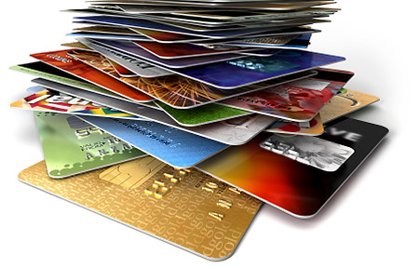
Cowries to credit cards
Understanding ancient Indian coinage.

Slide 2
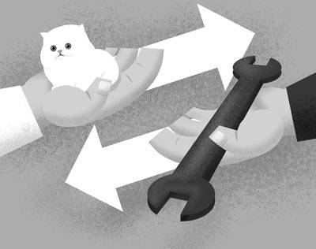
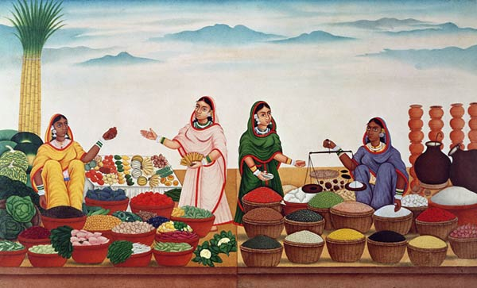
The Barter System : How Did it work?
Bartering is the exchange of one product or service for another without the use of money. The word barter comes from the French word, barater, meaning “to trade.” Early civilizations used this type of exchange before there was money.
Here a cat is being exchanged for a tool.
Here women are taking grains and exchanging them with veggies!

Slide 3
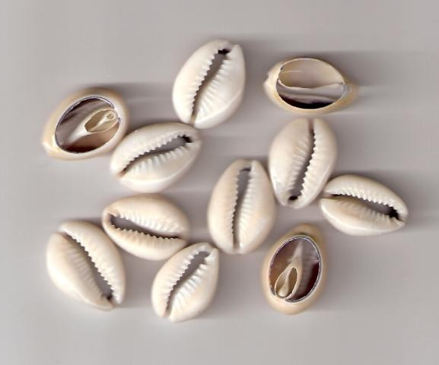
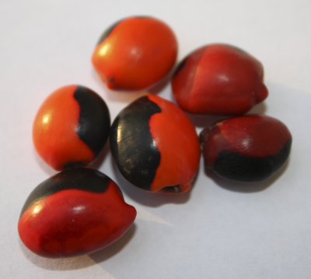
What did we do without coins?
Before the age of coins, the cowry shell was used as an instrument of payment and a symbol of wealth and power. The cowry , originating in India, was accepted in large parts of Asia, Africa, Oceania and in Europe. This kind of transaction continued till approximately the 6th century BCE.
We used cowries and seeds as coins, before we actually made real coins!
Notes:
Time period

Slide 4
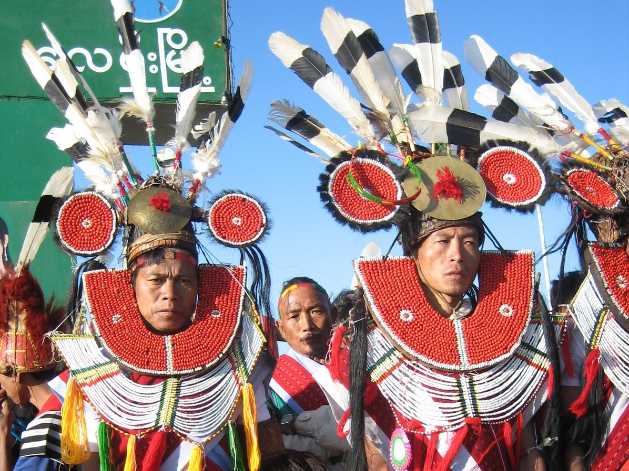
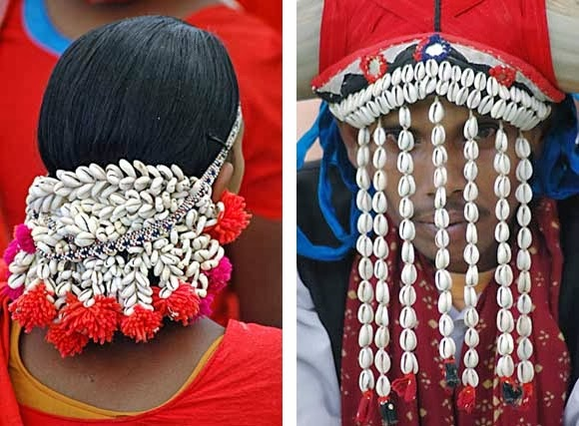
Due to it’s peculiar form, the cowry was also considered to be a fertility symbol, which made it extremely popular with a number of people.
Lion headdress of the Tangkhul Nagas, Nagaland, India.
Image courtesy: local-moda.blogspot.in
Man and woman from Bastar, Madhya Pradesh, India, wearing cowrie shells as adornments. Photo courtesy Pradeep Dadsena
Here are some other uses of cowries

Slide 5
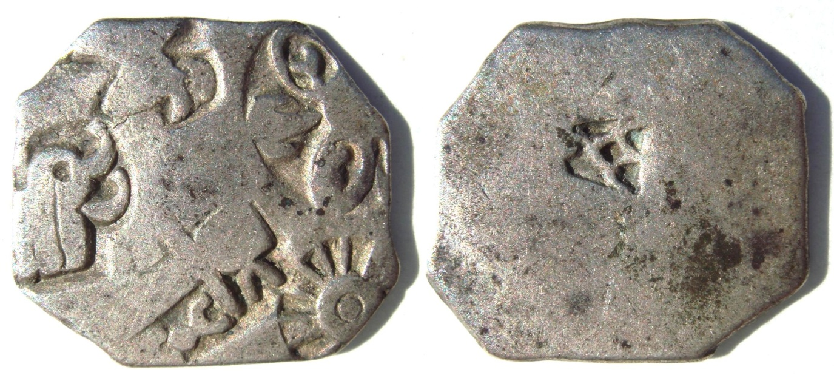
Earliest Coins: Punch Marked
These coins are called 'punch-marked' coins because of their manufacturing technique. These bear symbols, each of which was punched on the coin . The material used was mostly silver or copper.
The motifs found on these coins were mostly drawn from nature like the sun, various animal motifs, trees, hills etc. and some were geometrical symbols.
An elephant A Sun motif

Slide 6
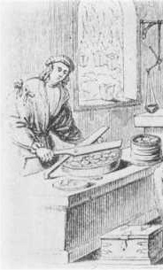
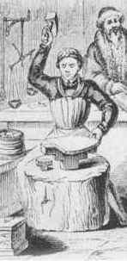
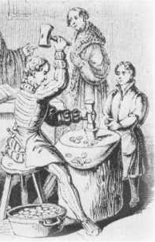
How to punch a coin?
Step 1: Cutting strips of metal (silver/copper) to coin size
Step 2: Flattening metal strips/coins into shapes
Step 3: Punching symbols on metal strips/coins

Slide 7
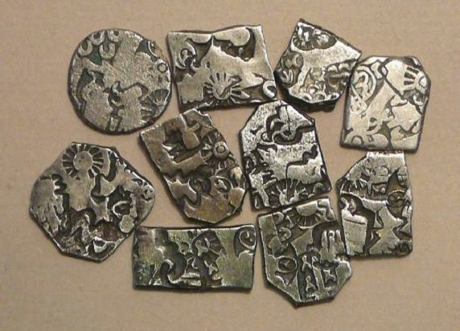
Digging up the first ever coins!
The punch marked coins were excavated over the length and breath of India, beginning in the 19th century. More and more such coins have been found since then.
Karshapana Coins, Maurya Dynasty, 1st – 3rd century CE. Courtesy: www.antiques.com
They are broadly classified into two periods:
The period of the Local States
The period of the Imperial Maurays

Slide 8
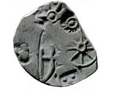
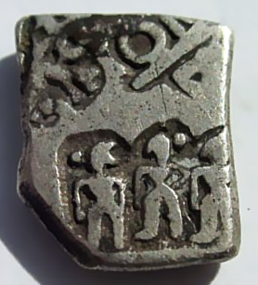
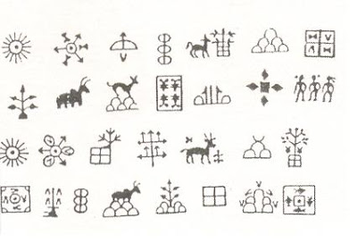
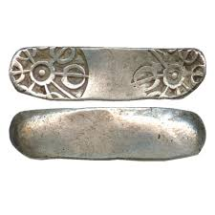
More Symbols in a punch marked coin

Slide 9
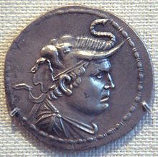
Indo – greeks: Who are these people on coins?
Many years ago, a Greek ruler called Alexander travelled to India and established his empire here.
They began to be called Indo-Greeks. They made coins with Greek gods and portraits in them.
What is the material they used to make these coins?
This one is of King Demetrius, the first Indo Greek king.

Slide 10
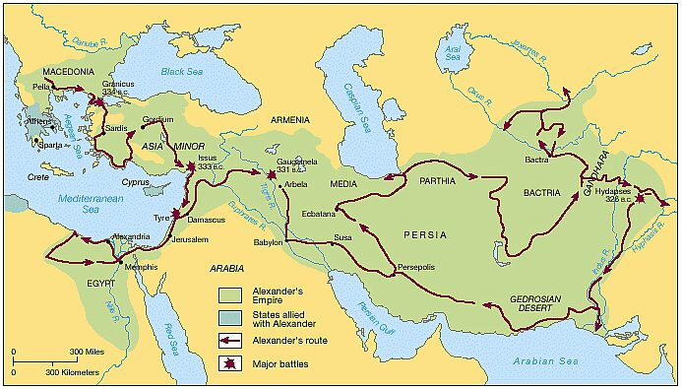
The Journey of Alexander!
All the way from PELLA to GANDHARA

Slide 11
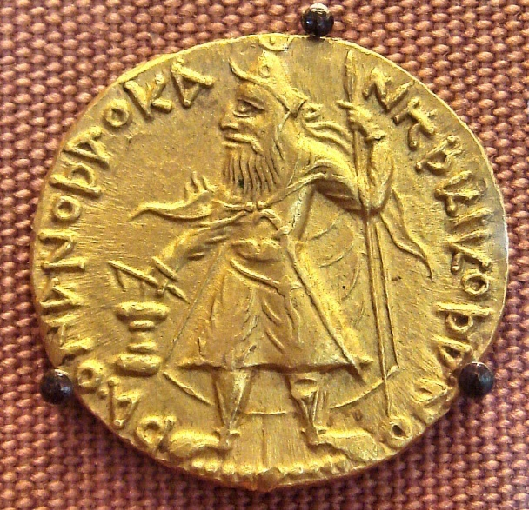
The Curious Case of Kushana Coins
After the Greeks, a group of Nomads from a little village in China reached India and stayed here.
These rulers came to be known as the Kushanas.
Do you know how they managed to conquer India?
Today, we find many coins from the Kushana dynasty. They do look a little different.
Can the Kushana coins tell us about their culture and society?

Slide 12
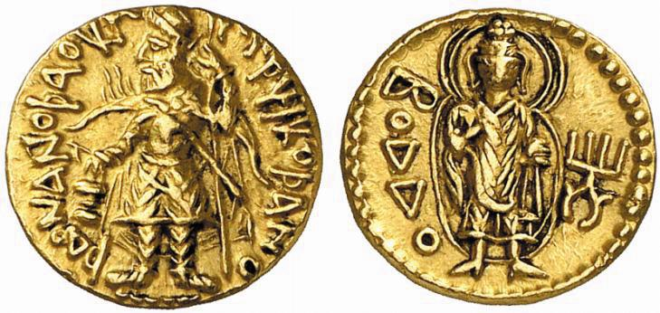
The Curious Case of Kushana Coins
Obverse : Portrait of King
Reverse: Image of Buddha
Hey! I can read this!

Slide 13
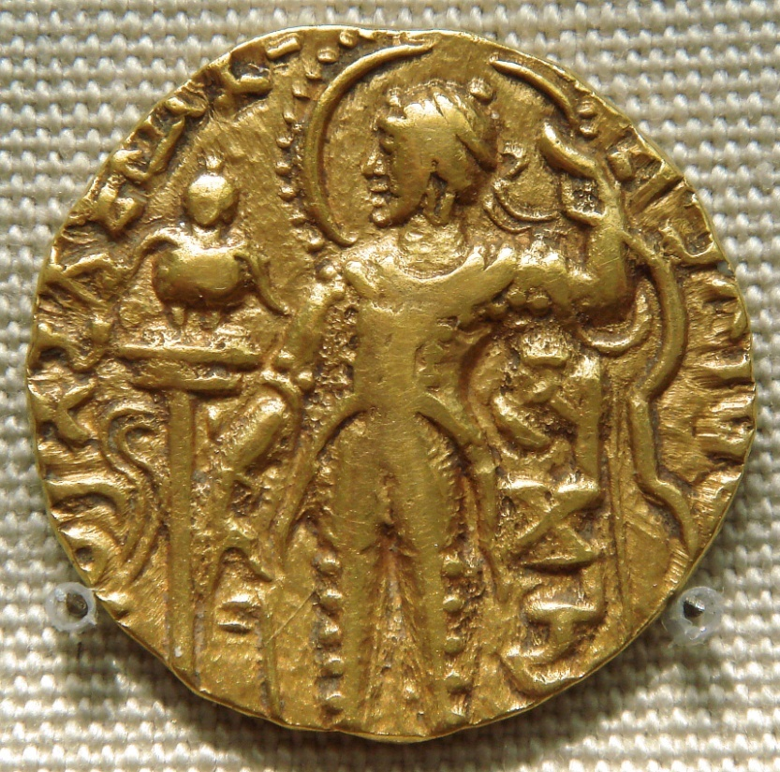
Gupta dynasty: the age of gold
The Gupta Dynasty, began by Chandragupta, lasted from 320 CE to the 5th century CE. Samudragupta was one of their greatest rulers, who is mostly known because of his coins.
These coins made sure that the ruler was portrayed as a great king and brave warrior.
Can you think of any reasons for doing so?
Samudragupta issued as many as 8 different types of coins for himself.
They are known today as Standard, Archer, Battle Axe, Chandragupta-I, Kacha, Tiger, Lyrist and Asvamedha type.
What do these coin types indicate?

Slide 14
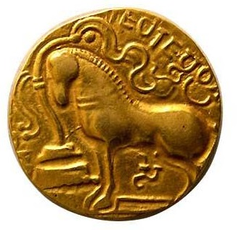
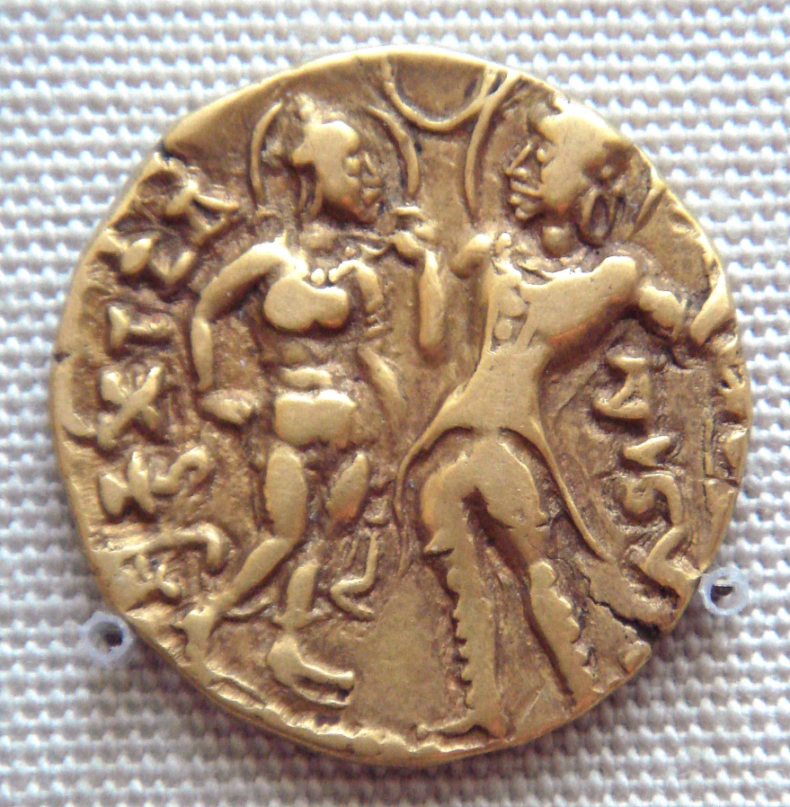
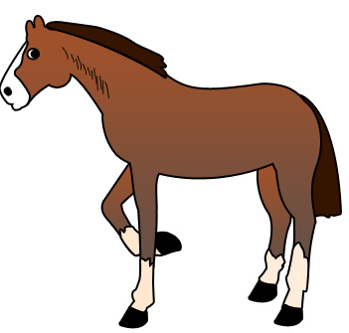
Gupta dynasty: the age of gold
Why does this coin have a horse?
Samudragupta with his Queen

Slide 15
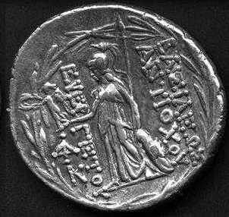
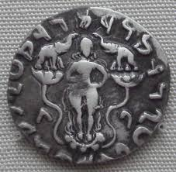
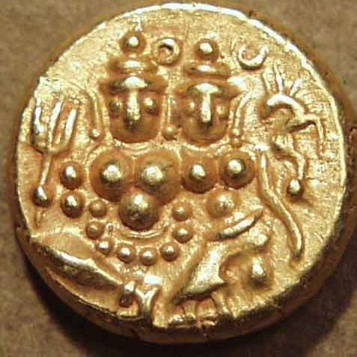
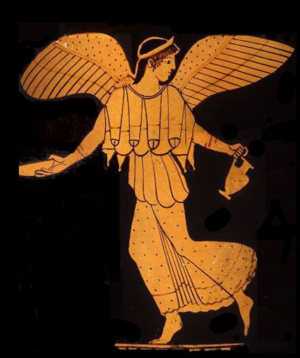
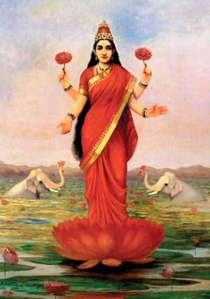
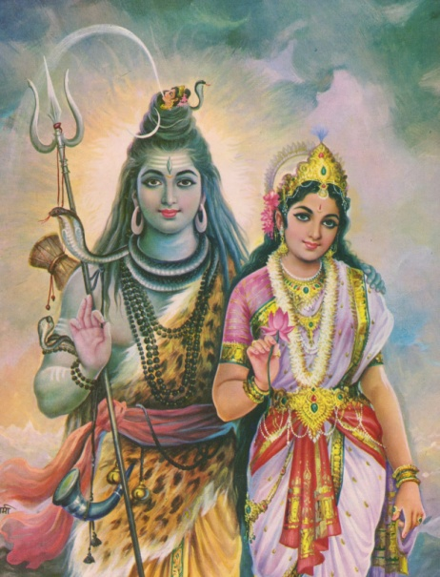
Did we worship coins?
Who is this?
Notes:
This is a nice slide but

Slide 16
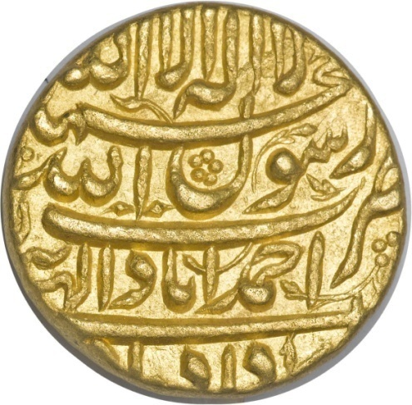
Do you know about the Mughals?
The Mughal dynasty in India began in 1526 CE when Babur defeated Ibrahim Lodhi, the Sultan of Delhi.
The most significant monetary contribution of the Mughals was to bring about uniformity and consolidation to the system of coinage.
Do you know this language?
Do you know the script?
Do you know the difference between “Language” and “Script” ?

Slide 17
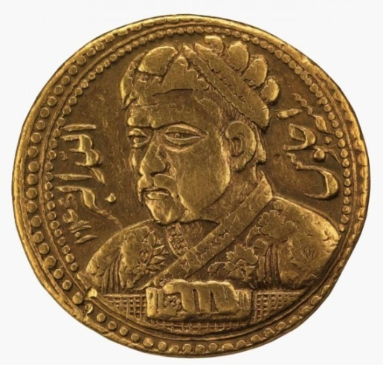
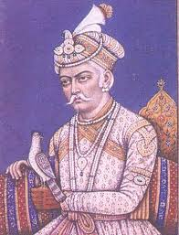
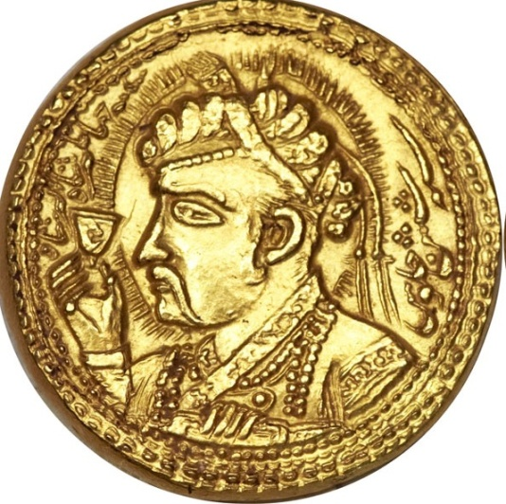
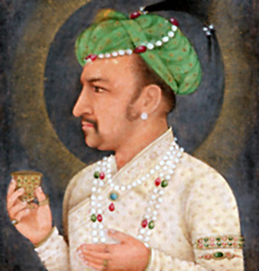
Do you know about the Mughals?
Mughal King Akbar
Akbar’s son King Jahangir
Remember any other kings who made portraits?
Remember any other king who used gold to make coins?

Slide 18
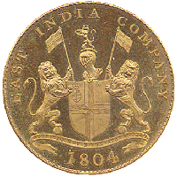
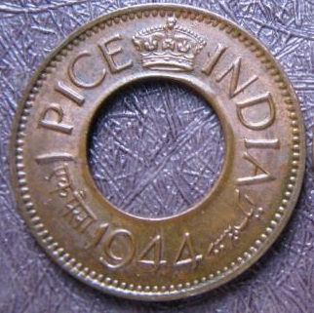
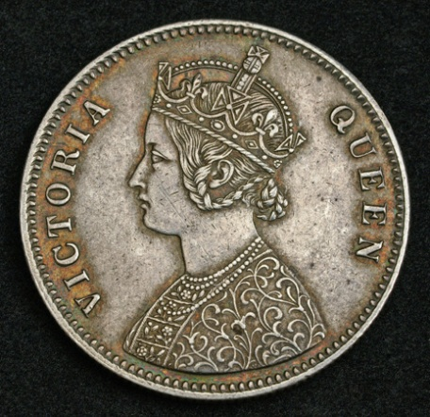
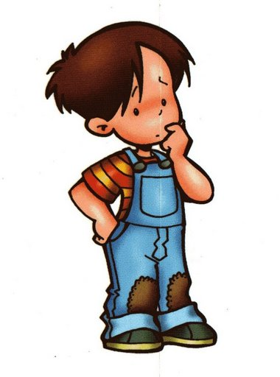
Look what the British got us!
Have you ever seen a coin like this?
The Emblem of the East India company
What IS the East India Company?
She was our Queen from 1876 – 1901

Slide 19
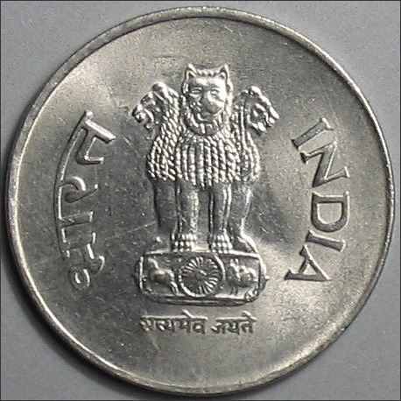
FROM coins to cards: Coins of independent India
After the British left India, we began minting official coins and printing notes.
This is when we began to call our currency “Rupee”.
Do you know what this symbol is? Why is this symbol so important?
Who was SHER SHAH SURI ?
Do you know “Rupee” comes from “Rupaiya” ?
Did you know Sher Shah Suri called his silver coins “Rupaiya”?

Slide 20
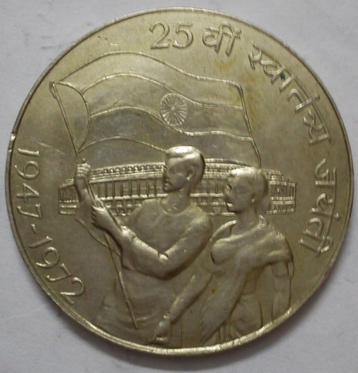
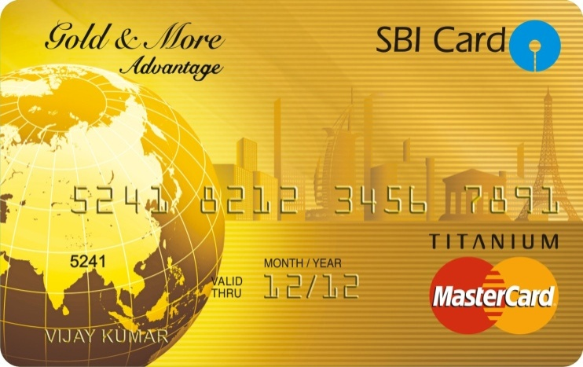
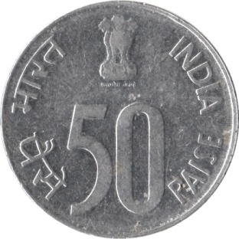
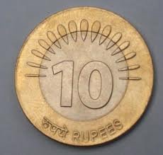
FROM coins to cards: Coins of independent India
This too is MONEY!
When India turned 25!
20
Two 50 paise coins make 1 Rupee.
Twenty 50 paise coins would make a 10 Rupee coin.

Slide 21
It’s time for us to explore the world of ancient coins now!
When you look at these precious objects at the National Museum, remember to ask yourself some questions like
HOW OLD IS IT?
WHAT IS IT MADE FROM?
WHERE WAS IT MADE?WHERRE WAS IT USED?
WERE THESE THE SAME PLACES?
WHO USED IT? WHO MADE IT?
DID THE OBJECT TELL YOU SOMETHING ABOUT PEOPLE OF THE PAST?
DID YOU LEARN SOMETHING NEW ABOUT OUR ANCESTORS?

Slide 22
Further reading :
Bhandarkar, D. R. Lectures on Ancient Indian Numismatics. Asian Educational Services, 1990.
Brown, C. J. Coins of India. Asian Educational Services, 1992.
Kosambi, D. D. Indian Numismatics. Orient Blackswan, 1981.
MacDowall, David William. Indian Numismatics: History, Art, and Culture : Essays in Honour of Dr. P.L. Gupta, Volume 1. Agam Kala Prakashan, 1992.
Sircar, D. C. Studies in Indian Coins. Delhi: Motilal Benarasidas Publishers, 2008.

Slide 23
Visit National Museum website
www.nationalmuseumindia.gov.in
You can also explore our numismatics and epigraphy collection by visiting
http://www.nationalmuseumindia.gov.in/departments-miniature-numismatic.asp?lk=dp4

