Slide 1
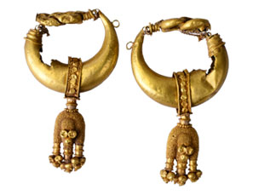
Alamkara The history of Indian Jewellery through the National Museum Collection

Slide 2
What does Alamkara mean?
The term “jewel” comes from the old French word Joule – as something that gives joy.
“Jewel” – Everything that gives joy
“Alamkara” is a Sanskrit word that means “adornment”.
What other objects give you joy? A rainbow? Or a soft toy?

Slide 3
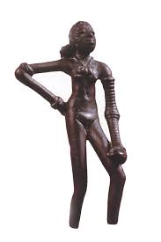
Our earliest Jewels
Do you know how old our earliest jewels are?
Almost 3000 years!
This statue is also as old as 3000 years.
Information about dancing girl. Importance of jewellary in ancient art.
Collection of NM New Delhi

Slide 4
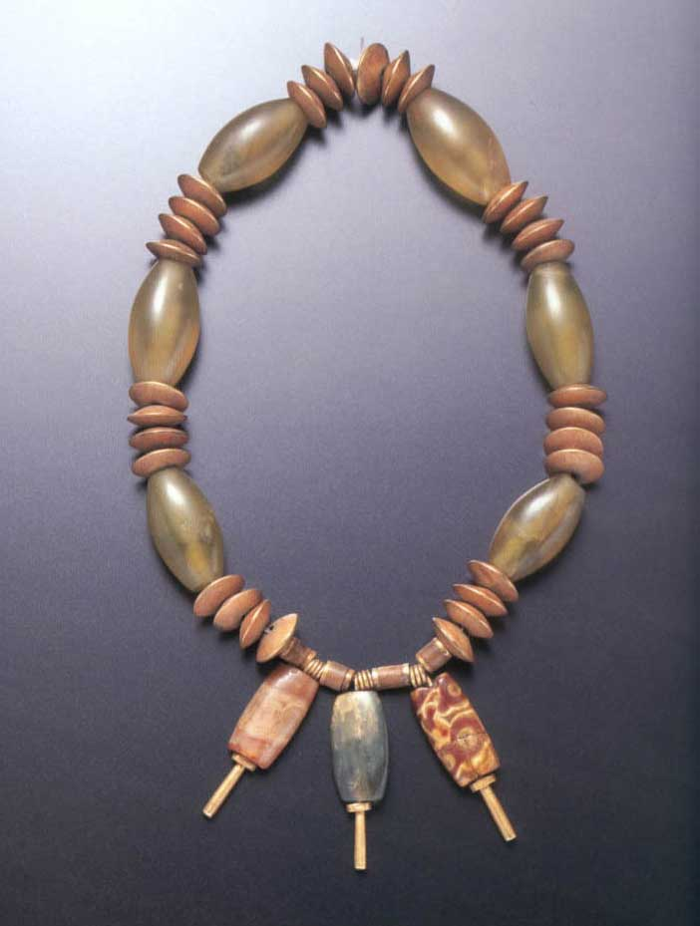
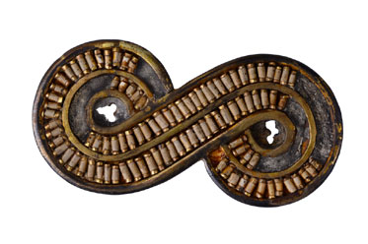
Information about these – patterns, material
Collection of NM New Delhi
Do you think patterns and styles repeat through history?
Collection of NM New Delhi

Slide 5
Ancient Jewelleries from an Ancient Land
These jewelleries come from an ancient city of Sirkap, in present day Pakistan.
Information about the Greek styles and making techniques.
Kings travelling with craftsmen
Jewellery identifiers of a civilisation/ dynasty/ region/ time.
Collection of NM New Delhi

Slide 6
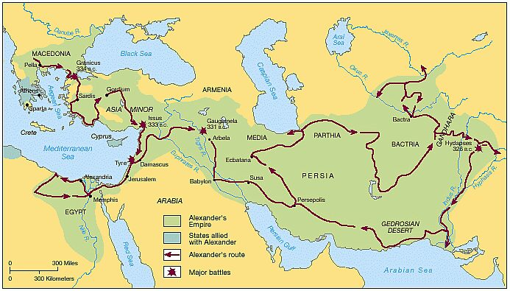
This is Greece This is Taxila
Lets talk about a brave young king, Alexander.
Courtesy: www.kingsacademy.com
HOW DID THE GREEKS TRAVEL SO FAR?

Slide 7
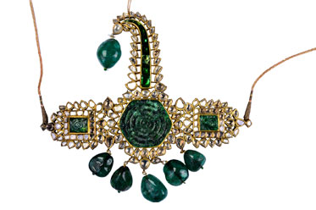
New Rulers and new jewels
The Mughals brought a new aesthetics to Indian Jewellery. Precious gems, gold and diamonds were brought out to make exquisite jewels.
What are the changes in these jewellery from the earlier ones?
Do you know who were the greatest Mughal patrons of jewellery?
Collection of NM New Delhi

Slide 8
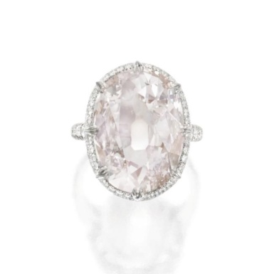
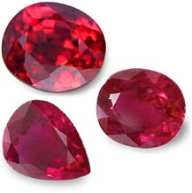
Jewellers of the South Jewellers of the North
Southern Jewellers make jewels through the Repousse technique.
Northern jewellers make jewels through a combination of metals, gemstones and polychrome enamel.
Photo to be clicked from gallery
Southern jewellery used these gems very often. Do you know where they come from?
This is made by a technique called Meenakari. Do you know more about it?

Slide 9
The age of European Jewellery
Princely states. Kings travelling abroad. European companies setting base in India. Catering to rich Indian patrons.
Minimal, Statement Jewellary.
Image of European Jewellery.
Courtesy: Pinterest.com

Slide 10
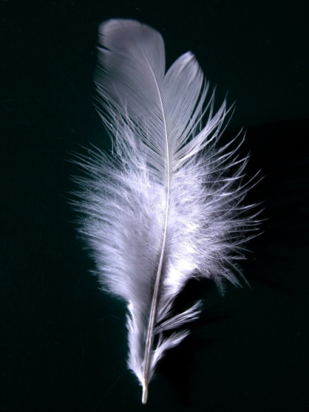
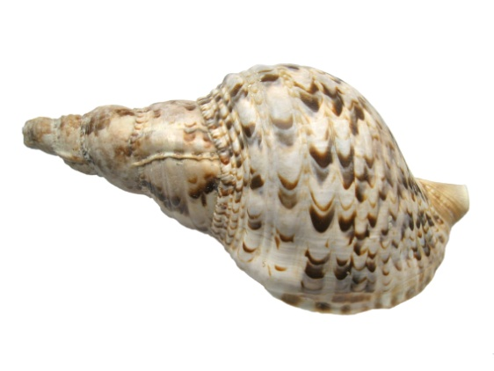
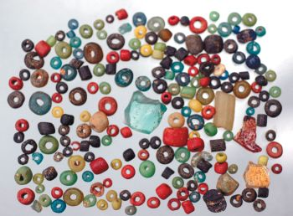
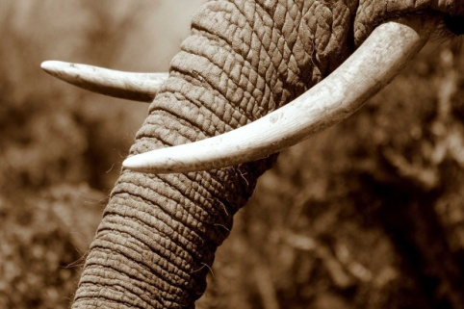
What is jewellery made of?
Jewels were a very important part of the human body. Without them, the body was considered imperfect. The earliest jewellery was made of many different materials.
Courtesy: wikimedia.org, frontline.org, wired.co.uk
Can you think of jewellery made with these?

Slide 11
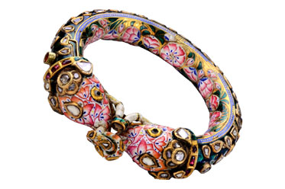
How are these Jewelleries made?
The technique of making jewellery has developed over history. Many techniques have continued unbroken till the present day!
Moulds and Dies
Repousse / nakshi/ nakashu-velai
Filigree and Granulation
Minakari and Kundan
What do these words mean?

Slide 12
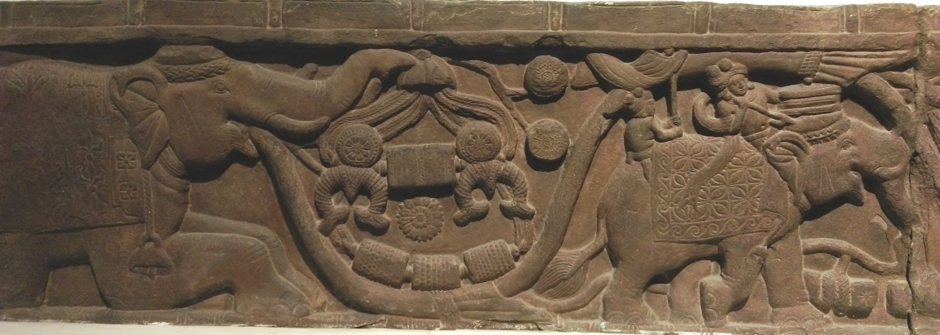
Jewellery meets Architecture and sculp
This is from a gate of an ancient city of Bharhut. It depicts a creeper that fulfils wishes.
Wooden Sculptures/arch.
This is from a wall of the Mughal city of Fatehpur Sikri. Why are there so many earrings on it?
Somebody wished for loads of jewellery.
Do you see them here?

Slide 13
Jewellery meets Art (basholi )
Was jewellery only meant for women?
Why was jewellery so important to the ancient people?

Slide 14
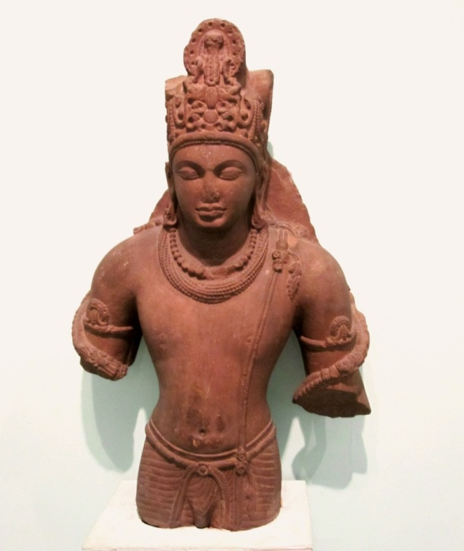
Jewellery meets religion
Our ancient jewellers took inspiration from the vast collection of mythology to create beautiful motifs in jewels.
Jewellery was also a very important part of the idols in temples.
Did it serve any purpose to put Gods in Jewellery? Or Jewellery in Gods?
Collection of NM New Delhi

Slide 15
Reference List
Brijbhushan, Jamila. Masterpieces of Indian Jewellery, D.B. Taraporevala Sons & Co. Private Limited, Bombay, 1979.
Kunz, G.F.The curious hore of precious stones, 1913. Col. T.H. Hendley& Lient, Jeypore enamels.
Brijbhushan, Jamila. Indian Jewellery Ornaments and Decorative Designs.1964.
Nigam. M.L. Indian Jewellery, Tiger books International, London, 1999. Krishnan, Usha .R.Bala and Meera Sushil Kumar. Dance of the peacock: Jewellery Traditions of India, India Book House limited, Mumbai.

Slide 16
Department of Lecturing & Education National Museum new Delhi Janpath Road www.nationalmuseumindia.gov.in nationalmuseumfacebook.com

